Slide 1
Reactive Programming
In java

Slide 2
What ?
Language → NO ← Framework
Thinking approach/ programming paradigms
Reactive systems
Responsive
Event or message driven
Scalable / Elastic
Resilient

Slide 3
Why ?
Industry demand/trend
Captive users, Response time
Application availability
Act on load
Sync/Async
Non-blocking
Backpressure
Resource utilization

Slide 4
How ?
Reactive Streams API
Implementations
RxJava
Akka streams
Java Flow API
Spring WebFlux
Reactor
Ratpack
Vert.X
….

Slide 5
Java 8 streams | Reactive streams
Pipeline | Pipeline
Lazy evaluation | Lazy evaluation
Push data | Push data
Error handle exception good luck | Deal with it downstream
1 Data channel | Data Channel Error channel Complete channel
No forking | Multiple subscribers
Push at will | Back pressure
Sequential vs parallel | Sync vs Async

Slide 6
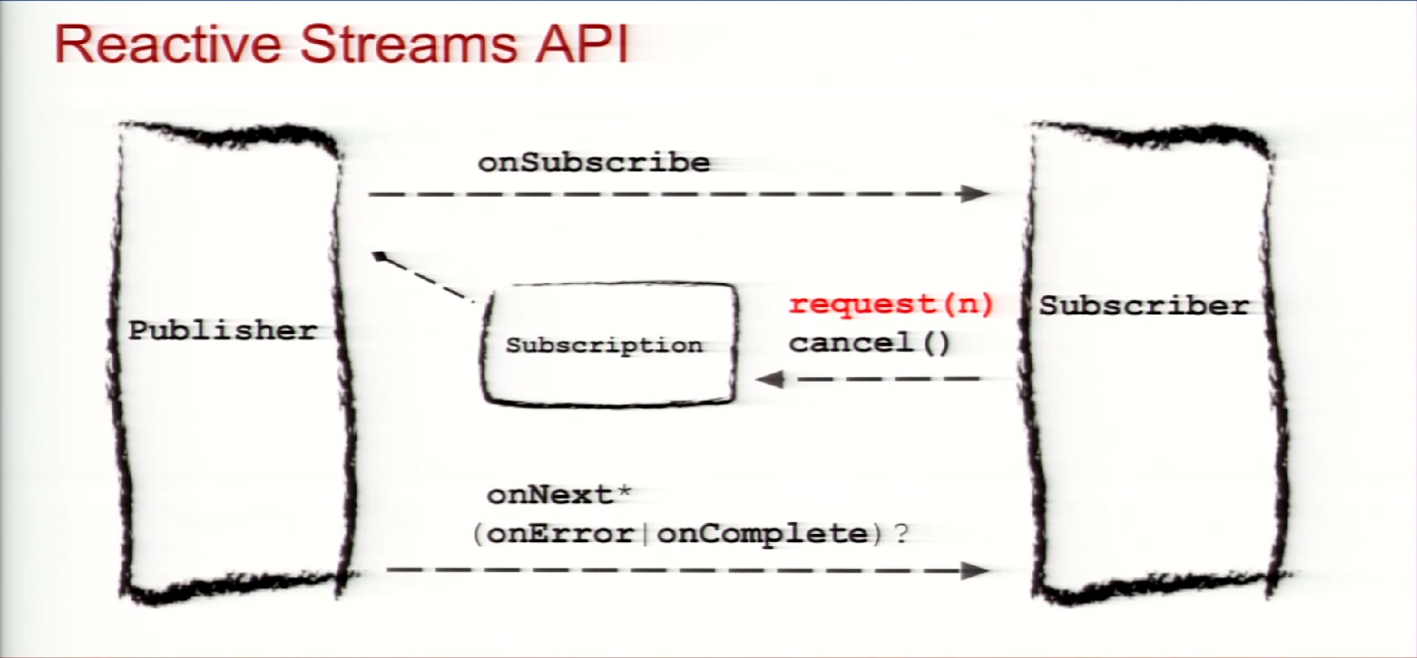

Slide 7
Reactive Stream API
Publisher – Emits data
Subscriber – Receives data
Subscription
Processor (publisher +Subscriber)
Java Flow API
Publisher
Subscriber
Subscription
Processor (pub +Sub)
Java.util.concurrent.Flow

Slide 8
References
http://www.reactive-streams.org/
https://www.baeldung.com/rxjava-2-flowable
https://dzone.com/articles/what-are-reactive-streams-in-java
https://www.journaldev.com/20723/java-9-reactive-streams
YouTube videos on Reactive Programming

Slide 9
Thank You..!!!

